Slide 1

Before internship
Notes:
Good afternoon everyone,
Thank you for taking time off to be here today. For those who did not know me, I am Terry and I am doing Business Administration and Computer Science in NUS. I started my internship last month, working under Jax supervision.
Before my Internship I was this GUY.

Slide 2

After the Internship
Expectation
Notes:
After my Internship, I thought I am this guy.

Slide 3

After the Internship
Reality
Notes:
But reality, I am here This Guy. The story goes like this:

Slide 4
I learned:
SQL – basic level
NoSQL – basic level
Hadoop/ Hive – understanding level
HTML- Consolidated
CSS – Consolidated
Google Map API – basic level
D3.js – basic level
JavaScript - Intermediate
Notes:
I did not know a lot when I first started, so everything was extremely hard and frustrated. And my task (given by Jax) is a draw Hexagon heat map over Singapore to display data.

Slide 5
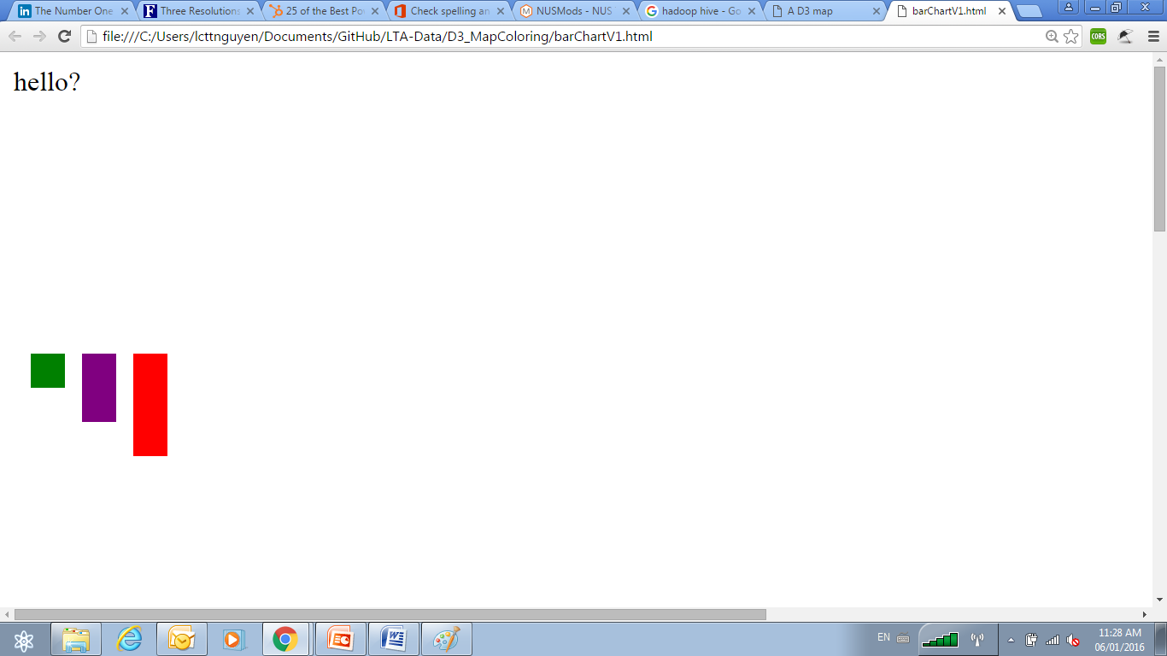
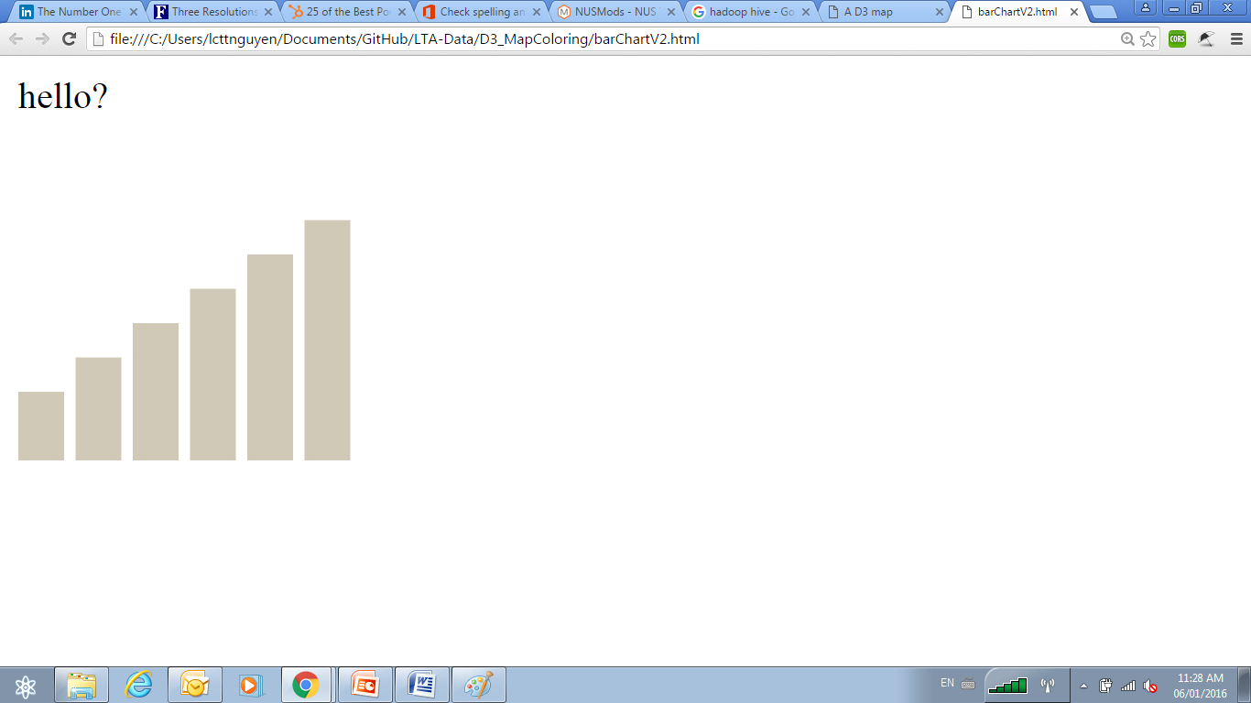
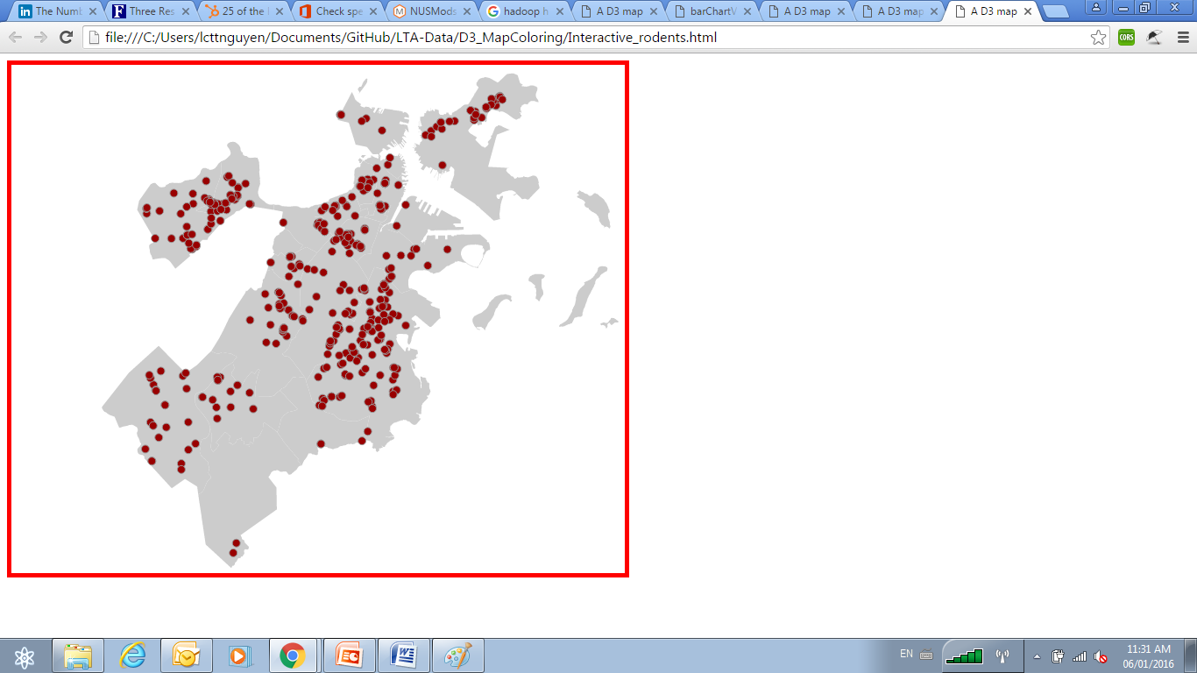
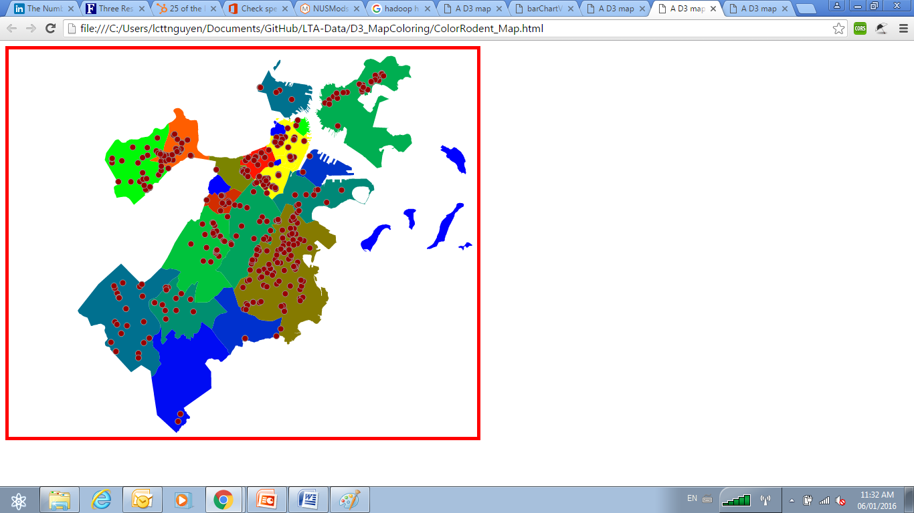
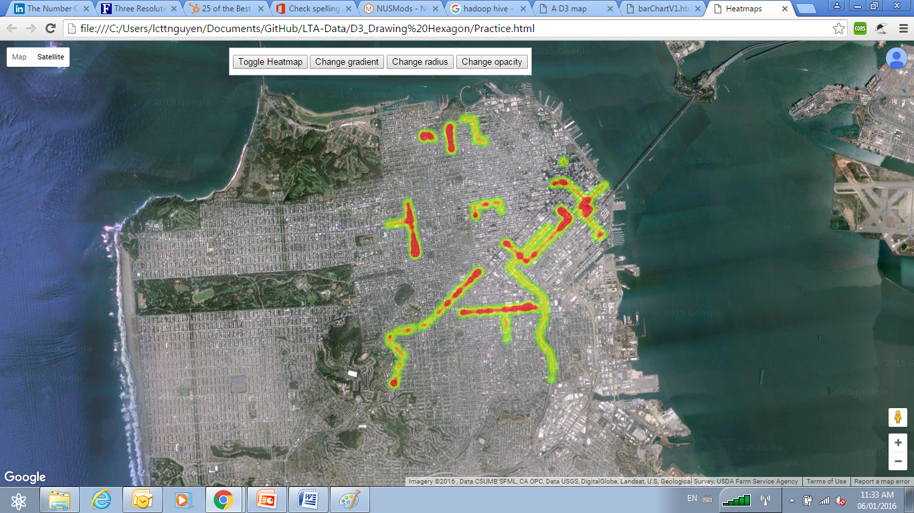
Week 1
Notes:
I started pick up CSS and JavaScript on how to draw bar charts, how to color bar chart, then I use D3.js to enhance the use of CSS ,and Javascript to process location data to draw this map. Then to color it base on some property.

Slide 6
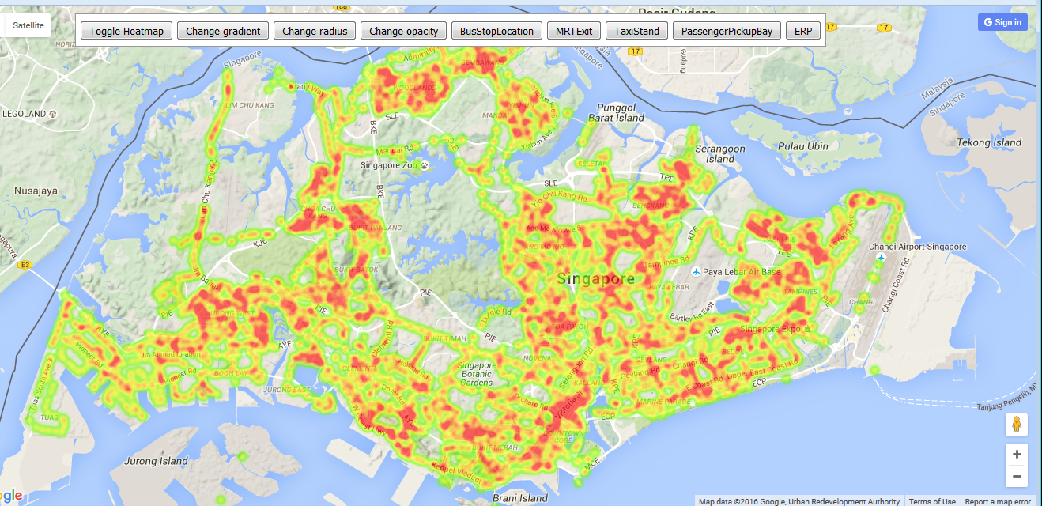
Heat Map using Google API
Notes:
Then I finally discover that I could have just use google API to produce a much prettier heatmap (expected laughters), I didn’t tell JAX I was using Google API and I hope he did not notice, but he did.

Slide 7
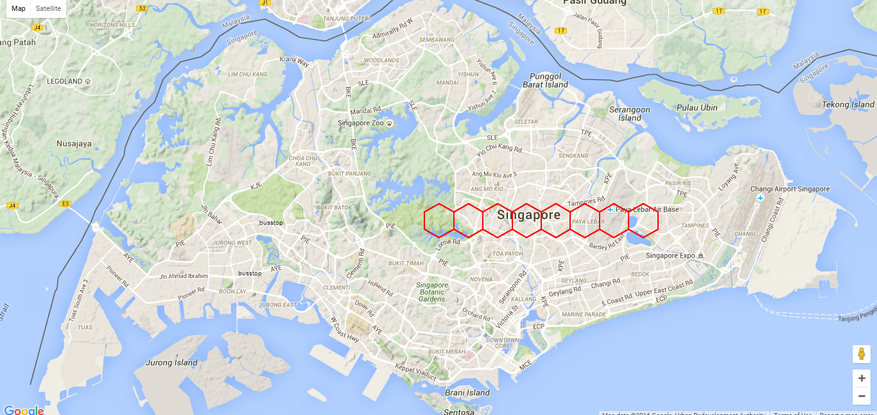
Using D3.JS
Notes:
So yeah, I need to get back to do D3.js. Learning to draw hexagon poses a problem as well, I need to calculate where the center of the hexagon, and where the lat and long on the map, then other problems arises as well.

Slide 8
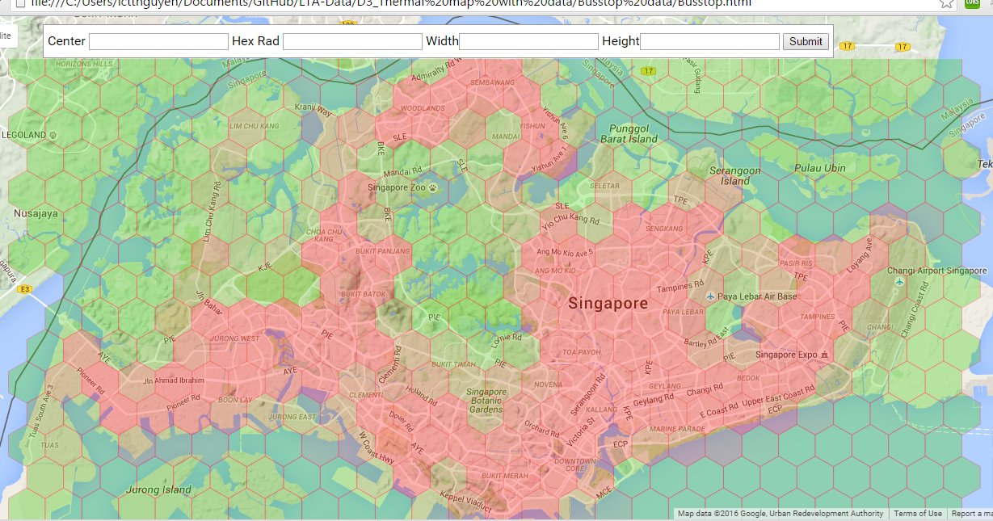
Finally
Notes:
However, finally, after intense help from Jax, i am able to draw a hexagon overlay and integrate it with LTA data on busstop location, and produce my final product.

Slide 9

Telco Big Data Product
Notes:
After that, I went into research about what could be done with analytic data in Starhub.

Slide 10

Table of Contents
A
Overall Research Paper and Introduction
11
B
Case Study: API enablement
18
C
Case Study: Matching demand & offering nearby
23
D
Case Study: Real Time Analysis
38
E
Case Study: Congestion control
47
F
Case Study: Dynamic profiling and segmentation
55
A/11
E/47
F/55
B/18
C/23
D/38

Slide 11
Overall : IBM big data in Telecom
Conductor:
IBM & Said Business School at University of Oxford.
Industry:
Telecommunication
Finding:
Commit initial efforts to customer-centric outcomes
Develop an enterprise-wide big data blueprint
Start with existing data to achieve near-term results
Build analytics based on business priorities
Create a business case based on measurable outcomes.
A/11
E/47
F/55
B/18
C/23
D/38
Notes:
I came across a research paper, done by IBM in collaboration with Said Business School at University of Oxford.

Slide 12
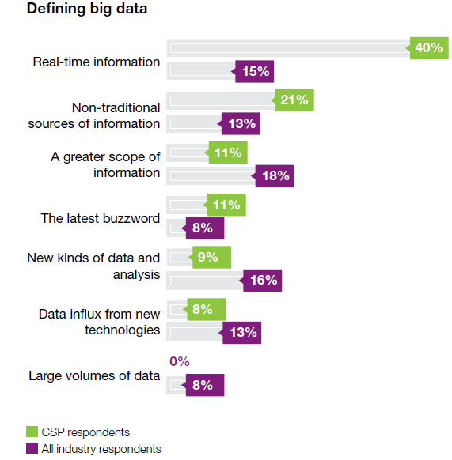
Sample size: 1,144 Business and IT Executives 53 from Telecommunications
Bid Data Role
A/11
E/47
F/55
B/18
C/23
D/38
Notes:
The paper suggests that CSPs that can ingest and analyze contextual data in real-time or near-real time have much to gain. Within big data lies the opportunity to derive new insights and predict trends that may spark new ways of doing business internally or externally.
Using big data in delivering location-based services, tailored marketing campaigns, next best actions for sales and services, network intelligence, social media insights and high-velocity fraud detection has the potential of both increasing revenue and reducing costs, often while improving the customer’s experience.

Slide 13
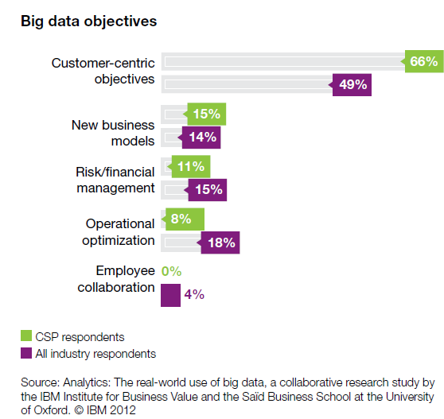
Business Direction
A/11
E/47
F/55
B/18
C/23
D/38
Notes:
Based on the paper, no matter if CSP planning to use big data to support their core businesses or just for sales as source of revenue, CSP need to develop a road map, set up adequate infrastructure and adopt new methods, processes and tools to
manage the unique volume, velocity, variety and veracity
requirements of big data. By analyzing survey responses, five key findings emerge that reveal common insights and trends:
• The CSP should focus on addressing customer-centric objectives
The emerging pattern of big data is focused on delivering
measurable business value.
• In order to advance, a scalable and extensible information management foundation need to be set.
• CSPs are beginning their pilots and implementations by
using existing and newly accessible internal sources of data
• Advanced analytic capabilities are required, yet often lacking,
for CSPs to get the most value from big data

Slide 14
Customer-centric Objective
Telefonica’s Brazillian subsidiary, Vivo
Using Call Data, Demographics and predictive modeling.
Offer discounted upgrade options
“Smart Steps.”
Using Location-based data
Tailor local offering for existing stores.
Verizon’s Precision Marketing division
Using Location-base data, before and after event.
Joint promotional opportunities and ticketing packages
A/11
E/47
F/55
B/18
C/23
D/38
Notes:
Take Customer-Centric Objective as a main focus for analyzing data.
Telefónica’s Brazilian subsidiary, Vivo, implemented a solution that uses call data, demographics and predictive modeling to reach out to customers and only offer them products and services that match their needs and
Lifestyles. Hence preemptively contact customers who have recently exceeded their allotted
calling minutes and offer discounted upgrade options that will prevent future overages.
This approach is likely to result in a positive customer experience. These types of customized marketing promotions can help to prevent churn, increase sales and lower marketing campaign costs.
Telefónica’s Dynamic Insights division launched its first service
in November 2012: “Smart Steps.”This service is designed to provide insights to retailers to help them tailor local offerings for existing stores, and determine the best locations and most appropriate formats for new stores.
Verizon’s Precision
Marketing division has already trialed its solution with a sports team. Joint promotional opportunities and ticketing packages have boosted season ticket sales by up to 35 percent

Slide 15
Risk & financial management Objective
Using real time analytics tools could reduce fraud by more than US$100 million per year.
For example:
T-Mobile ➔ high-value subscribers and services to better target its capital expenditure and networking engineering.
A/11
E/47
F/55
B/18
C/23
D/38
Notes:
According to the paper, a CSP executive estimated that using real time analytics tools could reduce fraud by more than US$100 million per year for the Telecommunication industry in US. As well as driving down overall debt-collection costs, targeting risky customers also has the added advantage of lowering churn rates.
T-Mobile in the United States, for example, is collecting a staggering 17 billion events a day from its network, storing this data and running analytics on it. This analysis enables T-Mobile to examine and correlate network performance with high-value subscribers and services to better target its capital expenditure and networking engineering.

Slide 16
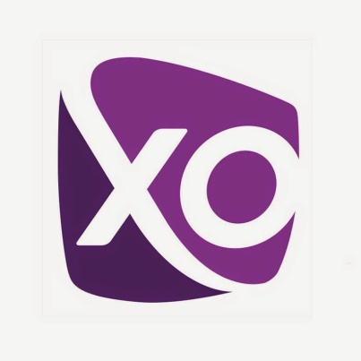
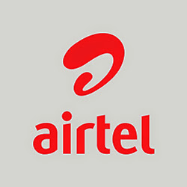
Non-traditional source of INFO
Monthly account-management cycle
XO communication
60% improvement in revenue
Social media content
Bharti Airtel, tracking and follow up
any problems
A/11
E/47
F/55
B/18
C/23
D/38
Notes:
Furthermore, non traditional data could also be used as in the case of XO Communication
a wholesale and enterprise-focused CSP in the United States, has been using predictive analytics with its monthly account-management cycle to predict churn. Within the first year, a 60-percent improvement in revenue retention rates was realized.
By combining social characteristics with existing behavioral knowledge, CSPs are able to create extended and deeper
insights to engage and retain customers. Social network analytics can also be used to find key influencers and engage them with customized messaging, to evaluate how new campaigns, product and services are resonating, and to quickly respond to negative chatter to protect their brands and reputation. Bharti Airtel, for example, uses social network analysis to determine customer issues by tracking mentions of the company on social media and following up on any problems.

Slide 17

Ways of Implementation
Use Cases
Potential Spill-Over Effect
Data exposure & API enablement
Matching demand & offering nearby
Real time analysis
Congestion control
Dynamic profiling and segmentation
Effecting marketing
Segmentation of customers for accurate marketing campaign
Enable location-based and personalized advertising
A/11
E/47
F/55
B/18
C/23
D/38
Notes:
The research paper might have suggest a general approach that Telco can use to tackle the huge amount of data.
However, in order to see that other Telco in the world are doing with their data, we should go into a few use cases.

Slide 18
Data exposure & API enablement
A/11
E/47
F/55
B/18
C/23
D/38

Slide 19
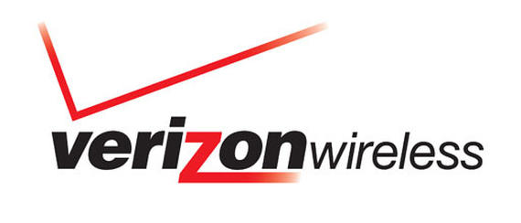
A/11
E/47
F/55
B/18
C/23
D/38
Notes:
Verizon wireless is one of a few telco that has started to provide API for external developers.

Slide 20

Verizon Service Control Gateway Architecture
3rd Party
Server
3rd Party
Server
3rd Party
Server
Network API Gateway
Privacy Manager –Provided by Oracle
Communication services: SMS, MMS, Terminal Location
**Actual architecture can be found in Appendix
A/11
E/47
F/55
B/18
C/23
D/38
Notes:
Verizon Wireless exposes a range of Network APIs that allow partners and third party application developers to design applications using Verizon’s network capabilities.
Basically, Verizon provides
» Location APIs support;
» Granular (precise) or AGPS location; and
» Coarse (cell ID-based) location.
» Messaging APIs support send, receive and delivery receipt to Verizon wireless subscribers; and
» Admin APIs support aggregator and enterprise features.

Slide 21

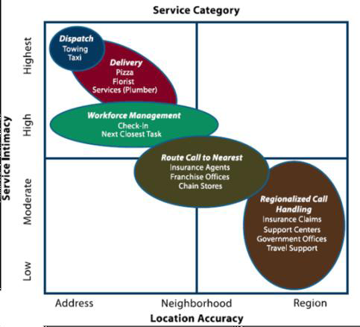
Verizon Customers
Reduce Dispatch Cost
Automatic routing call
Reduce call time and hassle of Location
A/11
E/47
F/55
B/18
C/23
D/38
Notes:
Partnering with TechnoCom, who is a leading provider of products and services to deliver wireless and location-based services applications.
[The concept of the “location enhanced” call center and Interactive voice response IVR is simple, customer services use the knowledge of the caller’s location to improve the services delivered, resulting in a faster, more economical, and better customer experience]
Figure shows some of the use cases on what business model that TechnoCom is trying to provide:
Basically, technocom is trying :
» Help callers even when they don’t know where they are to reduce costly dispatch mistakes and to substantially reduce the costs of customer service time by reducing service call duration.
» Automatically routing calls made to a central number to the local point of sale to leverage the personal service from local stores and franchises to close more sales and deliver better service.
» Reducing the hassle and time in answering the question “Where are you?” to realize service provider cost savings and improve customer satisfaction.
Take the Dispatch, Towing and Taxi use case as an example.

Slide 22

For Example
Confirmation for location base
Schedule and Dispatch Truck
SMS Notification
Gaining from API charges
A/11
E/47
F/55
B/18
C/23
D/38
Notes:
When someone breaks down and calls roadside assistance, the IVR will confirm if it is OK to get the person’s location for only that call. As the agent has the location information, time is saved and human error is removed. Then when the truck is scheduled, an SMS is sent to the person with the truck’s estimated time of arrival and contact information, which further saves call center agent time. The savings enabled by the location and messaging API can be in the order of tens of dollars per event, so the API charges are negligible.
The difference in value between the wholesale business of exposing APIs and delivering value to businesses highlights an important consideration for CSPs. As they expose APIs, they are enabling innovation with the business models created on top of the APIs is where significant value is created.

Slide 23
Matching demand & offering nearby
A/11
E/47
F/55
B/18
C/23
D/38
Notes:
Lets see how Telco matching demand and offering by using aggregated data

Slide 24
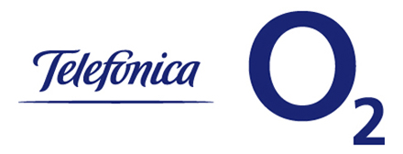
Telefónica Dynamic Insights (TDI) is part of the Telefónica Digital product family.
TDI is focused on the development of products and services that leverage on Telefónica’s global big data assets.
Provide mobile insight solutions
Use Insights to help organizations and firms
Enabling them to improve their propositions and businesses.
A/11
E/47
F/55
B/18
C/23
D/38

Slide 25
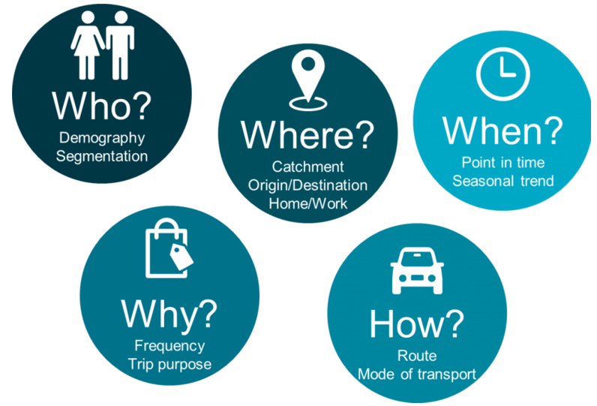
Smart Steps *
*Product of Telefonica Dynamic Insight team
A/11
E/47
F/55
B/18
C/23
D/38
Notes:
Smart Steps ,is a product of Dynamic Insight, it processes the “Big Data” created by the mobile network then analyses trends and patterns within the data to help understand more about consumer behaviour including

Slide 26

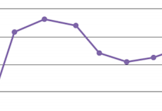

Telefonica O2 – Smart Steps
Measure Compare
Understand factors
Trends & Locations
New policies
Laws
Increase no. of visits
➔New retail outlets
➔Performance
A/11
E/47
F/55
B/18
C/23
D/38
Notes:
Telefonica uses Smart Steps to :
Measure/ Compare/ Understand what factors influences number of ppl visiting a location at any time
Gains insights to tailor local offerings for existing stores & determines best location and most appropriate formats for new stores.
Study the effectiveness of new policies.Help government measures traffic after implementation of new rules. E.g. Free car parking, farmer markets or late night shopping.

Slide 27

Swindon Designer Outlet is a covered designer outlet in Swindon, Wiltshire, England.
The outlet is owned by McArthur Glen
105 stores
3 million shoppers visit per annum
A/11
E/47
F/55
B/18
C/23
D/38
Notes:
One of the customer of Smart Steps is Swindon Designer Outlet in UK, with 105 stores and more than 3 millions shoppers visit per year.

Slide 28
O2 retail smart step case study
Customer:
Swindon Designer Outlet
Industry:
Retail sector
Problem:
Under-performing of outlet
Solution:
Using data to support the theory that the Swindon store was underperforming for its location.
A/11
E/47
F/55
B/18
C/23
D/38
Notes:
For this case, the problem is that the Swindon Designer Outlet is performing poorly in term of revenue, hence, they approach Smart Step Team to find out if they could provide data to support the theory that Swindon performing lower than exceptable standard is due to its location.

Slide 29


Evaluation Process:
23 million
customers
Method: Extrapolate billions of mobile events on its
network to gain insight , which is representative of the total population in each area.
We ended up with a really clear understanding of the store’s catchment and the types of customers we could expect to see
A/11
E/47
F/55
B/18
C/23
D/38
Notes:
Smart Steps uses anonymised and aggregated mobile network data from O2’s 23 million customers. Instead of, traditional data capture methods are based on occasional samples, modelled or claimed behaviour, Smart Steps takes billions of mobile events on its network and extrapolates data to provide insight representative of the total population in each area.

Slide 30


Clear understanding of catchment and Customer types
Action: Expansion of business into adjoining unit, and employ more staffs
72% increase footfall
14% increase sales
A/11
E/47
F/55
B/18
C/23
D/38
Notes:
They ended up with a really clear understanding of the store’s catchment and the types of customers Swindon could expect to see. Based on that, Swindon manager sought board approval for the business case for expansion. They proposed doubling the size of the store by expanding into an adjoining unit, and taking on more staff.”
Result: In the two months since the store’s expansion and refit, footfall has increased by 72% and total sales are up 14% from the previous store layout.

Slide 31

Morrisons is the fourth largest chain of supermarkets in the United Kingdom
A/11
E/47
F/55
B/18
C/23
D/38

Slide 32
Smart Steps increase Morrisons new and return customers by 150%
Customer:
Morrisons - UK’s fourth largest food retailer
Industry:
Food Retailer
Problem:
Increase visits, without increase investment
Solution:
Partnership with GfK, to shows trends of how many people visit an area by time, gender and age
A/11
E/47
F/55
B/18
C/23
D/38
Notes:
GfK is a market research firm. Since Morrisons don’t have store card to tell them who their customers are, they cannot implement effective targeted marketing, over-rewarding one customer disadvantages them in investing in the next one..

Slide 33
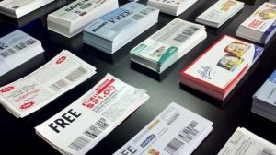
Break Down of The Problem
Visits 5 times/ Week
Brand different 2~3 brand/ 12 wks
Mathematic modelling is all estimated
High risk of wasting coupons, distribution costs
A/11
E/47
F/55
B/18
C/23
D/38
Notes:
With each household going shopping an average 4.9 times a week, averaging at two to three different supermarket brand visits in a twelve week period, Morrisons needed to find a new way to increase the number of customers visiting its stores.
The challenge facing supermarkets that use this method and do not have loyalty schemes is one of targeting. For Morrisons, the decision of which post code areas to distribute the coupons to was based on mathematical modelling, so it was all estimated.
They also running the risk of sending coupons to people who were never going to use them, or only one time customer.
“What Smart Steps offered us was a means to get real customer insight, instead of estimates. Using weighting and with Telefónica Dynamic Insight’s expertise, we could clearly see the best areas to target, and also the areas that we should avoid,” said Crawford. “There’s nothing else like Smart Steps on the market. Using its analysis of journey patterns, we could avoid sending coupons to households who already shop with us regularly, and combined with insight from gravity modelling, avoid targeting households in the direct vicinity of a competitor.” Morrisons decided to run a trial as part of a campaign in the South West of England. Of 11 million households, approximately 400,000 were targeted using insight from the team at Telefónica Dynamic Insights and Smart Steps.

Slide 34
Identify suitable postal code
Sending promotional coupons
Increase proportion of customer responded
Improve New Customer activation rates
Overall
150% in new customers
A/11
E/47
F/55
B/18
C/23
D/38
Notes:
“Smart Steps identified many more suitable target post code sectors, enabling us to send promotional coupons to double the number of households. This in turn generated an increase in the proportion of new customers who responded to the offer. This increase in customers was achieved without any reduction in customer spend, and with an improved new customer activation rate. Overall there was a 150%

Slide 35
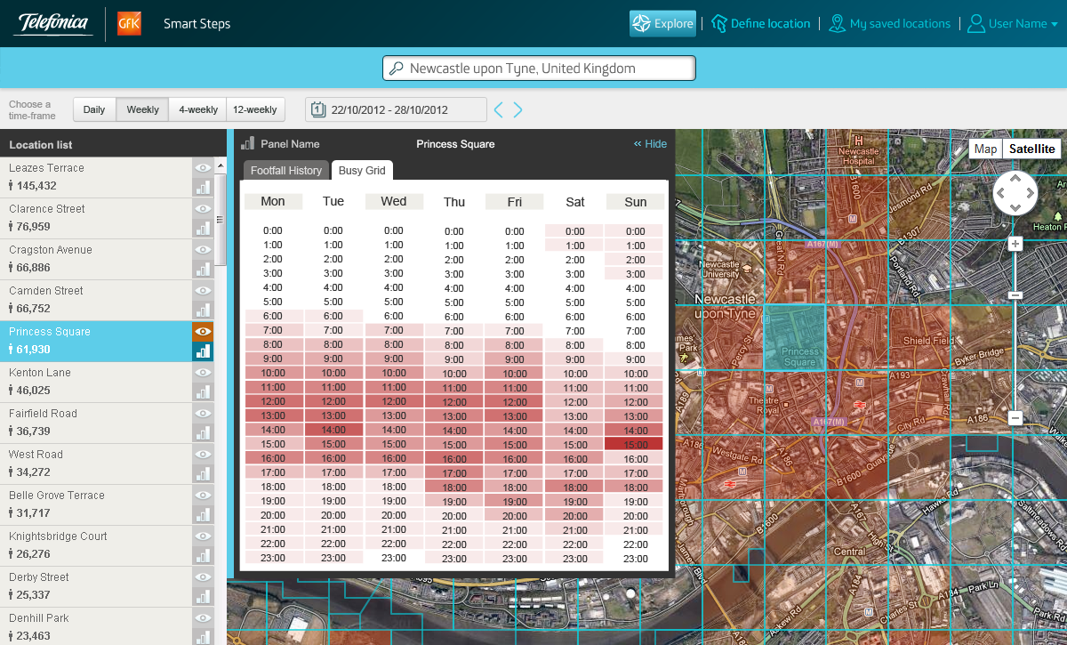
Solution
11 million households
40,000 were targeted
A/11
E/47
F/55
B/18
C/23
D/38
Notes:
Using weighting and with Telefónica Dynamic Insight’s expertise, they could clearly see the best areas to target, and also the areas that
they should avoid.
Using journey patterns, they could send coupons to household who already shop with them regularly, and combined with insights from gravity modelling, avoid targetting housholds in the direct vicinity of a competitor.
Morrisons run trials on 11 millions households, and 400,000 were targetted using insight from the team at Telefonica Dynamic Insights and Smart Steps.

Slide 36


Slide 37
Implication for Starhub
Decision making
Strategic Planning
Minimize Implementation Cost
Evaluation
Store performance, advertising policies
Frequency of Visits vs frequency of Purchase
Predict Demand
Planning for peak and troughs
Just-In-Time (JIT) inventory
Location
Investment planning
Traffic patterns
A/11
E/47
F/55
B/18
C/23
D/38
Notes:
Measures impact of decisions. Verify the impact that your decision on your outlets to minimize costs of implementation and strategic planning.
Measures store performance. Compare different stores, different locations, advertising policies , promotions campaigns to establish new effective ways to measure their performance. Understanding which sites have the highest frequency of visits vs frequency of purchase (revenue), and which locations have the most loyal customers.
Predict demand. Gain insights in planning for peak and troughs in demand to ensure the stores have the right resources available at the right time, this will ensure Just-In-Time Inventory. Cutting the storage cost, lower inventories holding at anytime. Furthermore, reduce the churn number due to low quality service, especially important for perishable products.
Understanding location- Enable more informed decisions on investment to certain locations by understanding the profile of the customers in the area, frequency of visits and number of traffic in and out of the location.

Slide 38
Real time analysis
A/11
E/47
F/55
B/18
C/23
D/38

Slide 39
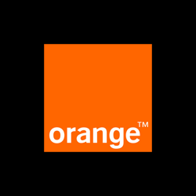
Orange S.A., formerly France Télécom S.A., is a French multinational telecommunications corporation.
A/11
E/47
F/55
B/18
C/23
D/38

Slide 40
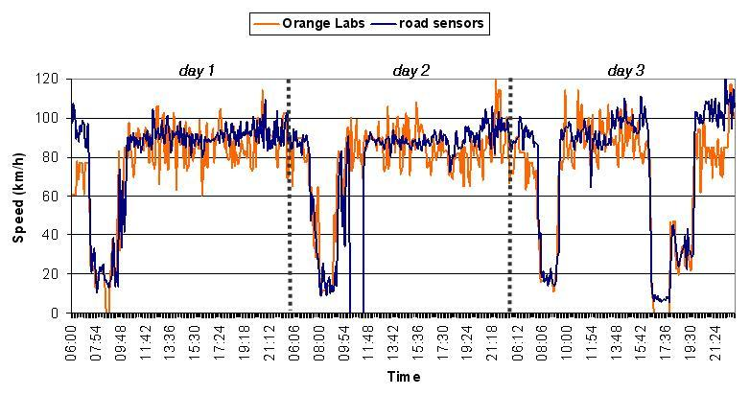
French western city of Toulouse.
A/11
E/47
F/55
B/18
C/23
D/38
Notes:
Wireless operator created a platform to generate road traffic data based on signal events in its wireless network. Orange Labs R&D is able to transform its GSM signal data into real time average speed on any road segment.
This can be done using roaming transmissions and handover signals. The various signals (and their intensities) can be used to locate a mobile phone in time and space

Slide 41
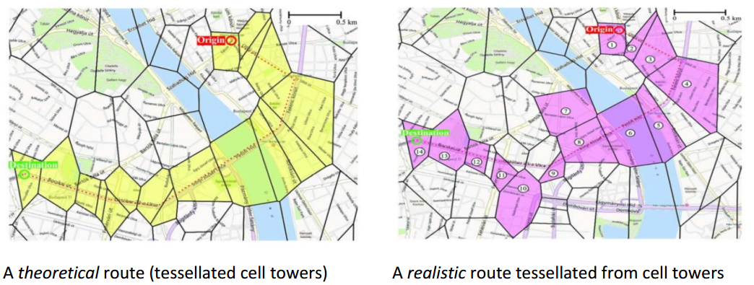
Problem in GSM by New Data Sources Research Paper
A/11
E/47
F/55
B/18
C/23
D/38
Notes:
This figure shows the reconstruction of a route using tower/phones signals. The right panel shows the actual data collected, and in the left-side panel, an ideal reconstruction of the route (in red) is shown. As can be seen, the raw signalling data will not always neatly translate into a path that can be mapped onto a street layer.
Sampling issues include multiple network providers covering the same area, multiple mobile phones per vehicle, and filtering out non-vehicle occupant phone signals

Slide 42
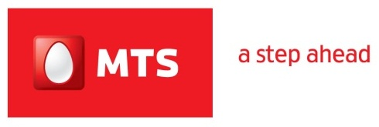
MTS India, the mobile telecom service brand of SSTL, has over 13 million customers' in India
A/11
E/47
F/55
B/18
C/23
D/38

Slide 43

MTS India
Customer:
MTS India
Industry:
Telecoms
Problem:
High turn over rate
Solution:
Partner with Hewlett Packard (HP) Enterprise to focus on customer loyalty and retention,
A/11
E/47
F/55
B/18
C/23
D/38
Notes:
MTS India, the mobile telecom service brand of SSTL, has over 13 million customers' in India.
Focus on customer loyalty and retention, which required IT to provide high performance analytics that is easily accessible by marketing to enable the rapid roll out of competitive incentive campaigns

Slide 44
Solution
Gather info
Process using HPE Vertica*
Rewards
*Vertica is the name of HPE analytic tool
A/11
E/47
F/55
B/18
C/23
D/38
Notes:
To keep tabs on customer activity, MTS primarily gathers usage data from its prepaid service customers from several core IT and Network elements, all collected by HPE Vertica for marketing campaigns. This data staging / loading solution provides a business-critical platform for the development of online, close to real-time MTS marketing campaigns for direct 1 to 1 customer outreach. The MTS system allows the telco company to capture what a customer is doing at any given point in time, and provide an instant customer gratification offer around that usage.

Slide 45
Furthermore, MST India
Used to | Now
Batch Processing | Automatic real time processing
Industry success rate 3% | Successful promotion  to 6%
Limited to 24 hr data Update | Processing done in 30 minutes
A/11
E/47
F/55
B/18
C/23
D/38
Notes:
Before MTS began running analytics against its data, the company used what the CIO described as “a rudimentary system for batch processing of data related to marketing campaigns, which limited us to a 24 hour gap between receiving the critical data and making new offers to the customer. Back then, we were collecting data from IT and network elements, then sending it to a standard database implementation for our back-end, where we stored campaign-related tables and customer segmentation data.” So making a decision will be delayed. Now, with the advance processing analytic tool, they can process data within 30 minutes and react to the problem at hand.

Slide 46

“By rewarding new or recently upgraded customers with surprise bonuses in the form of extra minutes or additional data, we have more than doubled our conversion rate, from an industry average of 3% to an unprecedented 6.5%. No one else in our marketplace is achieving these numbers.”
Marketing teams are now able to run U&R campaigns independently, without involving IT support
— Rajeev Batra, CIO, MTS India Telecom
A/11
E/47
F/55
B/18
C/23
D/38
Notes:
U&R = Usage and Retention

Slide 47
Congestion control
A/11
E/47
F/55
B/18
C/23
D/38

Slide 48

&
A/11
E/47
F/55
B/18
C/23
D/38

Slide 49
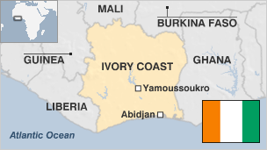
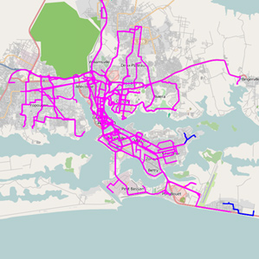
Ivory Coast
A/11
E/47
F/55
B/18
C/23
D/38
Notes:
Researchers at IBM, using movement data collected from millions of cell-phone users in Ivory Coast in West Africa, have developed a new model for optimizing an urban transportation system.
The prescribed changes in bus route around the city is base on the people movement discerned from cell-phone data. The data is used based on 2.5 billion call records from five million cell-phone users in Ivory Coast from Orange Telecom

Slide 50

Benefits
Remove the human factor in conducting survey on traveler’s route.
➔ Saving on cost
Produce real-time Snap Shot routes
➔ reducing travel and wait times
A/11
E/47
F/55
B/18
C/23
D/38
Notes:
Researchers at IBM, using movement data collected from millions of cell-phone users in Ivory Coast in West Africa, have developed a new model for optimizing an urban transportation system.
The prescribed changes in bus route around the city is base on the people movement discerned from cell-phone data. The data is used based on 2.5 billion call records from five million cell-phone users in Ivory Coast from Orange Telecom

Slide 51

A/11
E/47
F/55
B/18
C/23
D/38

Slide 52

Traffic solutions
Customer:
City Management & midsize utilities
Industry:
Government Sectors
Problem:
Overcrowding, High Accident rate
Solution:
+Better allocation due to incident report.
+Improve traffic flows
+Identify inefficiency
+Updates on road accidents
A/11
E/47
F/55
B/18
C/23
D/38
Notes:
Siemens is looking to provide insights in to:
Better allocation and distribution of resources based on information from incidents, service disruption.
Analyzing the movement of people to improve traffic management, park capacity, location, and number of first unit responders. City officials can better prepare and react to potential bottlenecks and other issues in case of an emergency.
Identify inefficient traffic pattern so that they can improve traffic management/ re-rounted/ better allocate public safety resources in places where majority of people congregate.
Monitor social media updates so as to report bad weather, major traffic accidents or traffic jams locations so that the city can take best course of action.

Slide 53

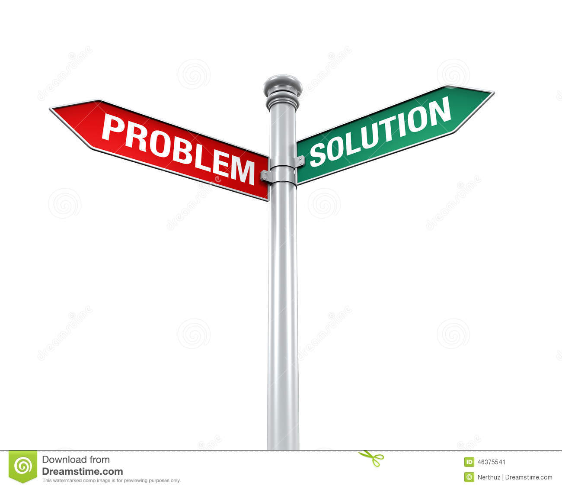
Traffic solutions
Traffic Volume
 Congestion
 Road Safety
Speed harmonization
Network diversion
Congestion Warning
*Highway authority South Bavaria, Germany
A/11
E/47
F/55
B/18
C/23
D/38
Notes:
Problem: Particularly, but not exclusively, in conurbations and metropolitan areas, constantly increasing traffic volumes are leading to more and more congestion on freeways and expressways. During peak times in particular, this has extremely negative impacts on travel times, traffic safety and traffic-related pollutant emissions. Consequently, the responsible authorities are looking for maximally sustainable ways of improving traffic flows without expensive construction measures to expand the motor - way network.
The solution
Using current traffic data as input, active traffic management approaches and dedicated control systems can manage high traffic volumes dynamically to counteract impending congestion. Improve traffic throughput, generates incident warning. Active Traffic management also include + Speed harmonization, Temporary Shoulder use, Ramp metering, Network control/ diversion, Congestion warning, Environmental information.

Slide 54
Traffic solutions
35% fewer
accidents
31% fewer
injuries to road users
20% reduction
in congestion hours
Enhanced road capacity
Improved traffic synchronization and higher capacity during peak hours
A/11
E/47
F/55
B/18
C/23
D/38
Notes:
Here are some striking results of current studies:

Slide 55
Dynamic profiling and segmentation
A/11
E/47
F/55
B/18
C/23
D/38

Slide 56
A/11
E/47
F/55
B/18
C/23
D/38

Slide 57
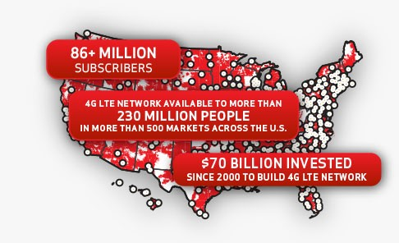
Precision Market Insights
National population
Locations
Demographic
Usage Data
Gender
Age
Target audience:
Media owners, sponsors, advertisers, venue owners and retailers.
A/11
E/47
F/55
B/18
C/23
D/38
Notes:
Precision market Insights was able to separate their data into different segment based on number of subscribers within a regions, demographic, usage or browsing patter, gender, age.
Precision Market Insights proceed to partner with BlueKai, the data management provider; Brightroll, a video ad platform; and the programmatic ad tech providers RUN and Turn.
The four will now sell its tool to advertisers for mobile ad campaigns that target Verizon's massive subscriber base based on demographics, interests and geography. Employing Anonymous Targeting called PrecisionID. When consumers visit certain websites or mobile apps, a request is sent through a Verizon network. Precision packages the request, as a hashed, aggregated and anonymous unique identifier, and turns it into a lucrative chunk of data for advertisers.
Verizon said it is not using or selling its first-party subscriber data, but rather deploying partnerships with third-party data providers to target Verizon's massive consumer base.

Slide 58

Connect Consumer Dots for NBA Teams, Sponsors
Learn about attdendees
Connecting Sponsor Message during game
Visits to sponsor location after the game
A/11
E/47
F/55
B/18
C/23
D/38
Notes:
They also collaborated with a fast food brand to observe traffic inside a basketball stadium.
The idea is to help teams and arenas learn more about event attendees, connecting the dots between sponsor messages at the game and visits to sponsor locations afterwards.
The National Basketball Association's Phoenix Suns tested the service for one season, and the Portland Trail Blazers are considering a partnership with the telecom's insights business.

Slide 59
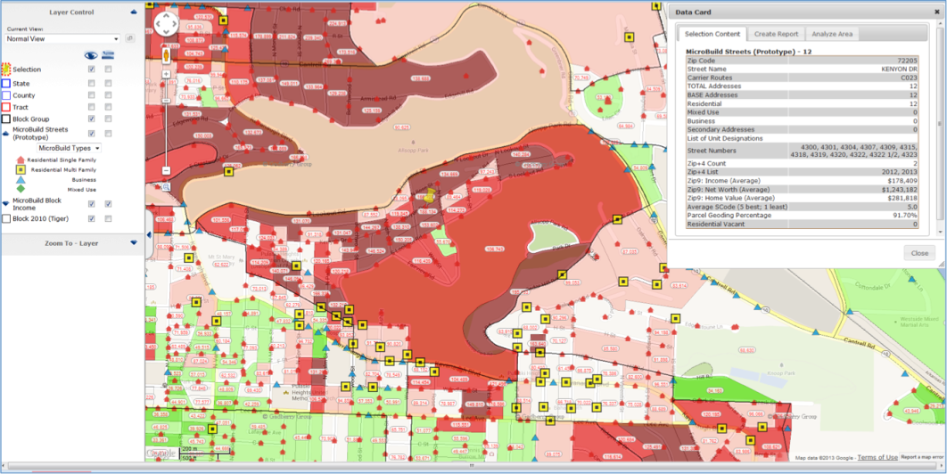
Solution
Utilize granular location data
Track Verizon Wireless-enable devices
Provide Aggregated Data on the types of people
Analyze buying pattern after the game
A/11
E/47
F/55
B/18
C/23
D/38
Notes:
Verizon uses that granular location data to keep track of which Verizon Wireless-enabled devices were in a sports arena, or near it, or at a particular fast food restaurant or car dealership. Though Verizon holds on to that device-identifiable data, it provides a more general view to its clients after "hashing" or anonymizing the data. Clients like the Suns end up with aggregated data on the types of people who visited a venue and later visited a sponsor's place of business.Verizon layers on another marketing services (Experian) profile data to segment consumers demographically. For example, it can report which percentage of an audience segment who attended a game then visited a sponsor's burger joint at a particular time on a given day afterwards.

Slide 60
8.4% in traffic following promotional games
Attendee’s demographic
Attendee’s Location
Campaign Response data
A/11
E/47
F/55
B/18
C/23
D/38
Notes:
After the trail, Jack in the Box the fast food eatery "experienced an average increase of 8.4% in traffic following promotional games,“
Verizon provided the team with demographic and location data, mobile usage information, and campaign response data.
In addition to illuminating consumer response to sponsor message, the data is also able to help the stadium to shed lights on their attendees.
Oftentimes one person buys multiple tickets, in which case teams and venues don't know who all of the attendees are. The secondary ticket market only obscures their view more.Thus, Verizon aims to fill in the blanks for venues on who's coming to their events

Slide 61
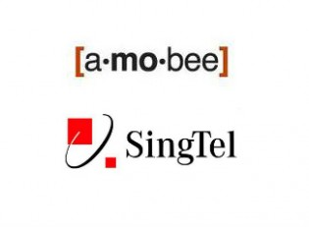
Amobee is a mobile advertising technology company providing services for large advertisers, publishers and operators
A/11
E/47
F/55
B/18
C/23
D/38

Slide 62




Amobee Acquisition
400 million
mobile customers
A/11
E/47
F/55
B/18
C/23
D/38
Notes:
Singtel, as compare to Verizon, takes a different approach to the matter by acquiring a mobile advertising firm Amobee. A vertical integration approach would allows Singtel to potentially enhance the capacities of Singtel Group operators in the Asia market in the emerging digital marketing technolocy, as well as creating a big opportunities for SingTel in emerging markets, such as India, Indonesia, Thailand and the Philippines.
According to Singtel:
Singtel already has advanced geo-localisation capabilities, as well as the means to empower customers to receive only relevant and customised offers and promotions catering to their needs and preferences while protecting their privacy. Furthermore, Singtel’s access to the Group’s over 400 million mobile customers offers a compelling proposition for brands wanting to reach customers in the emerging markets. Amobee complements these capabilities with a strong technical platform that serves ads, banner as well as video ads and an experienced team in mobile advertising.

Slide 63
Amobee and Lexus Automotive Case Study
Customer:
Lexus and Walton Isaacson
Industry:
Automotive
Problem:
Improve effectiveness and engagement
Solution:
Partnership with GfK, to shows trends of how many people visit an area by time, gender and age
A/11
E/47
F/55
B/18
C/23
D/38
Notes:
The problem Lexus and Walton Isaacson needed help reaching multicultural audiences in certain geographic regions, with the goal of increasing consideration for the IS and RX Lexus models, and driving qualified traffic to Lexus dealer sites.

Slide 64
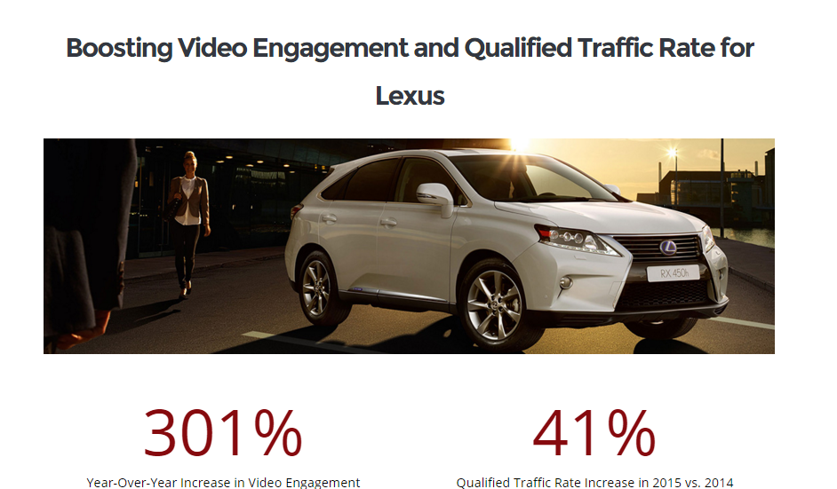
A/11
E/47
F/55
B/18
C/23
D/38
Notes:
Using Amobee audience targeting technology, qualified consumers were identified based on criteria like household income and content categories that supported Lexus brand values of innovation, performance, and technology.
Frequency capping ensured maximize brand awareness while maintaining efficiency throughout the campaign.

Slide 65
A/11
E/47
F/55
B/18
C/23
D/38
Notes:
Amobee’s audience targeting optimizations resulted in 301% higher user engagement and 41% more qualified traffic to Lexus dealer sites in comparison to 2014.

Slide 66
Notes:
GfK service

Slide 67
Notes:
HERE map application

Slide 68
Implication for Starhub
Control
Advertising performance
Analyze competitor activities
Platform
Identify best approach
Location-based
Promotions, offers, deals
Service Quality
Personalized mobile plan
Improve service and reduce churn
Determine best hour of the day
Push upcoming sales
A/11
E/47
F/55
B/18
C/23
D/38
Notes:
By combining the customer location information with customer demographics and preferences, CSPs are starting to provide Data Analytics as a Service (DAaaS) to other key verticals including: retail, financial services, advertising, healthcare, public services and other customer-facing businesses
Measure advertising performance at particular location by the rate of visits, the increase in number of visits to outlets, analyze competitor activities as well. This would allows a more informed understanddetermining ing for the return of investment in advertising campaign.
Finding effective advertising flatform. Potentially, identify location and match with particular demographic, time of the day for product pricing in Singapore, which is applicable for outdoor billboard, banners, advertising screen.
Advertising content based on location. Meaning, social media, websites and online content can be tailored to for advertising based on location of the person by showing near by promotions, discount, sales, or items of interest to the users based on their browsing pattern.
Personalized deals, offers, promotions and coupons. Advanced analytic would enable Starhub to engage in personalized offers and promotions, which helps to increase customers satisfactions and reduce spamming which eventually reduces churning. For example, using analytic system to monitor data usage, call minutes per month to offer additional package on top of the standard plan when the users reach their limits.
Advertisers partnering with Starhub could reach specific demographic segments on mobile, identify and serve ads to loyal customers, and re-target particular users based on our Data Science and Data Solution team.

Slide 69

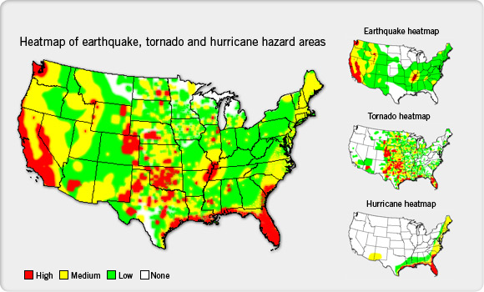
Insurance Company
If I’m an insurer that wants to accurately price insurance coverage on a particular house, I need to know, are you in an earthquake zone, a flood zone, or are you in an area that is prone to wildfires
-- Bill Sinn,marketing director
A/11
E/47
F/55
B/18
C/23
D/38
Notes:
Pitney bowes is eCommerce solutions, shipping and mailing products, location intelligence, customer engagement and customer information management solutions. And this is how it takes on Insurance Company.
“If I’m an insurer that wants to accurately price insurance coverage on a particular house, I need to know, are you in an earthquake zone, a flood zone, or are you in an area that is prone to wildfires,” says Bill Sinn, marketing director for insurance and healthcare at Pitney Bowes. “And, if I know a major storm is approaching I want to know, with precision, that I’ve got 50,000 policy holders that could be impacted.”
Sinn says that products like MapInfo Professional, which allow users to visualize geospatial data, have revolutionized the way insurance underwriters, actuaries, claims, and marketing professionals utilize the information. “Underwriters previously had to look at a spreadsheet,” Sinn says. “But now they can visualize it and look spatially and say, how many other policy holders do I have near that location?” While data used to be broken down by zip code, Sinn notes that MapInfo Professional lets users drop a pin in a location and then micro-analyze data however they choose—for example, by creating a mile-radius ring around the projected storm path.

Slide 70
Insurance Company
Profit
Efficiency
Profit
Offers
Pricing decision
Competition
Well informed
Accurate exposure
Up-to-date data
Distribution
Marketing
Maximize Effectiveness
A/11
E/47
F/55
B/18
C/23
D/38
Notes:
Hence, location intelligence tools can assist insurers by:
• Accurately assessing marketing potential, better focusing
marketing, sales, and distribution management, and
maximizing producer effectiveness
• Improving underwriting decisions by providing more
accurate exposure analyses
• Increasing competitiveness through more refined and
accurate pricing.
• Increasing organizational efficiency and profitability through
deployment of “low touch” or “no touch” automated
underwriting systems, augmented rules engine technology,
and enhanced service-oriented architectures supported by
web services applications
• Managing risk on a portfolio basis and complying with
regulatory reporting requirements
• Streamlining claims handling processes and providing
added-value customer service offerings

Slide 71
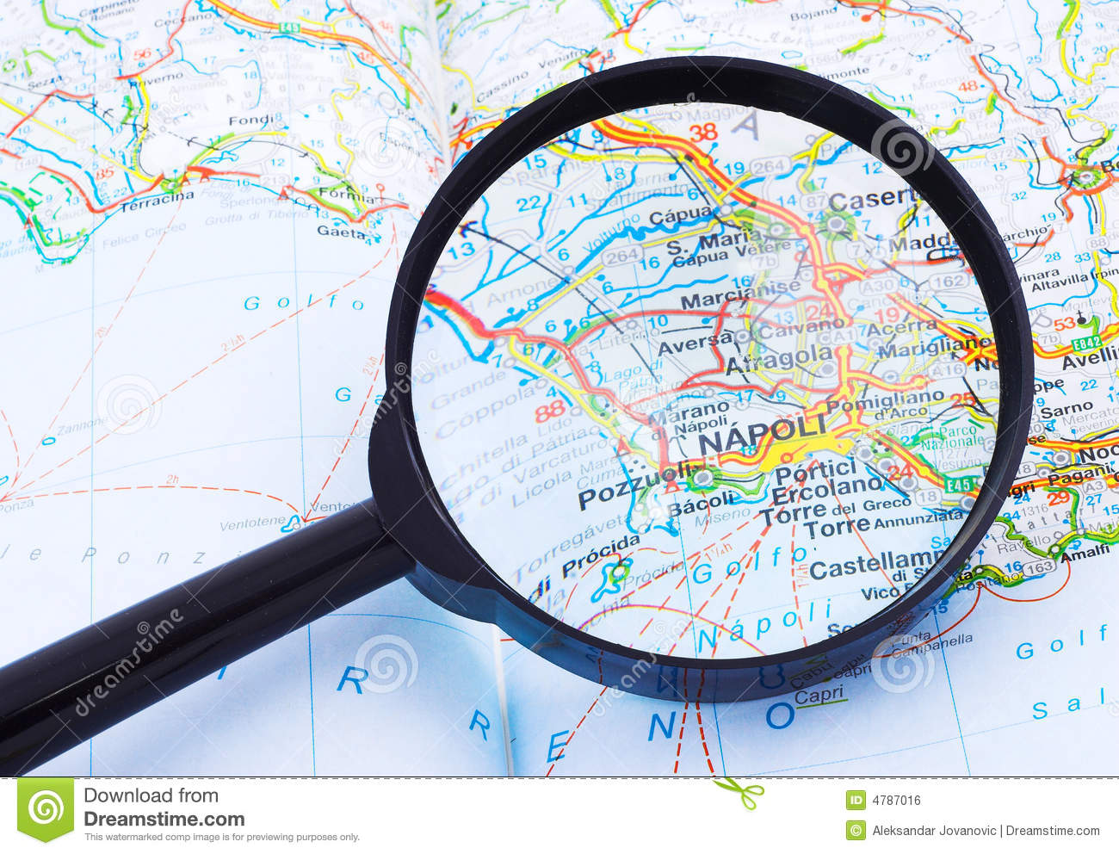
Banking Services
Currently,
$25 million.
$100 million worth of potential business
A/11
E/47
F/55
B/18
C/23
D/38
Notes:
Through the understanding of its trade area, they can assess its relative performance. For instance,
“Based on an understanding of the demographic profile of the area which suggests that there is $100 million worth of potential business in the area, but the branch is only generating $25 million.

Slide 72

Solution
Local Leadership
Product Mix
Demographic
Income
Competitive positions
Reassess the targets
Detect Fraud
Anomaly Credit card usage
Sending Offers
Manager
A/11
E/47
F/55
B/18
C/23
D/38
Notes:
Further evaluation can be conducted to better understand this shortfall. The regional manager could re-evaluate
local leadership,
the mix of products/services offered in that branch,
better understand competitive positions within the market,
and/or reassess the targets for that branch.”
Banks and credit card companies can also use location intelligence tools to better detect fraud, and also avoid flagging legitimate charges as potentially fraudulent. “As they start to develop profiles of where you shop, that makes it a bit cleaner to anticipate charges that on the surface might seem a bit outside the norm,” says Hempfield. “There’s nothing worse than when a customer tries to buy a plane ticket, and the bank, because the airline’s call center is in a different state or country, thinks it’s an illegitimate charge and rejects the purchase.”
Hempfield explains how financial institutions can use geospatial data to electronically send their cardholders special offers when they’re at or near specific stores. “Banks and credit card companies want to help drive additional business to their network of retailers,”

Slide 73
Implication for Starhub
API
Selling Processed Data
Provide Library to access Aggregated Data
Service
Provide analytic service
R&D
Possible solution for firms
Utilize solution team to solve customer
Identify potential threat
A/11
E/47
F/55
B/18
C/23
D/38
Notes:
Selling fraction of processed data- for a particular purpose (such as demographic, crowded area,etc) to LTA.
Selling a whole package of aggregated data. Which is the entire anonymous location based data of starhub customers. So that the buyers can further extract information or perform analysis so as to gain insights.
Selling a final product as a report for a particular purpose. E.g. Starhub could perform necessary analysis on the data obtained and then only produce the required report that the buyers want.
Furthermore, Research and Development into the current data and external data (if possible) could be used to identify out-break of diseases, disaster, social unrest and emering hot-spot.

Slide 74
Potential Future Direction
A/11
E/47
F/55
B/18
C/23
D/38

Slide 75

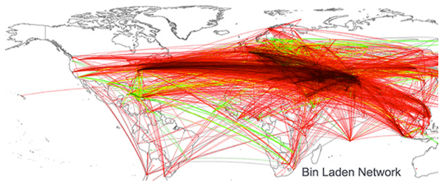
Government - Politics
Criminal activities and security protection
Using location-based report to predict political events
A/11
E/47
F/55
B/18
C/23
D/38
Notes:
Criminal activities and security protection. For instance, University of Illinois computer scientist Kalev Leetaru, written about being able to locate Osama Bin Laden’s location based on mining news report, basically, he connected cities together if they were mentioned in a same article. Then he ended up with the map as seen below, all roads lead to a 200-kilometer radius about Abbottabad. Personally, I would not say this as a reliable way to solve problems, however, this type of new research and studies on human behavior could potentially lead to exciting field of getting political intelligence.
Using location-based report to predict political events: Futhermore, predictive models can be built with data from social media conversations, mobile phones and browsing behavior. Potential illegal activities, gathering can be identify and prevented. Furthermore, historical data might as well give insights into potential triggers for such events in the future.

Slide 76

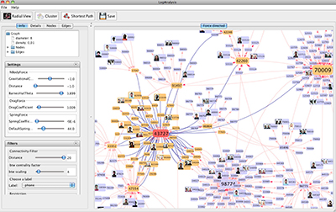
Center for Complex Networks and Systems Research
This network visualization shows a criminal network in Italy based on a case study using unique cell phones and phone calls.
A/11
E/47
F/55
B/18
C/23
D/38
Notes:
Ferrara, a post-doctoral researcher at Indiana University’s Center for Complex Networks and Systems Research,and collaborators from the University of Messina, Italy assisted police in Italy with investigations into murder, bribery, robbery, drug trafficking and prostitution by using social network modeling to conduct criminal network analysis using phone call data obtained by police.
“The researcher create what they call a dynamic spring layout — a series of nodes that represent possible members of criminal networks — and analyze how those members interact and shape their interconnections over time.” Using a software, LogAnalysis, it automatizes the import of raw telephone data, then removes recognized ambiguities and redundancies, before converting the information into a form ready for exploration and analysis. Once the criminal network has been identified, the relationships within such network is analyzed for hierarchical structure.

Slide 77
Reference:
Big Data Working Group: Big Data Analytics for Security Intelligence. (Sep 2013) - Cloud Security Alliance
Big Data and Advanced Analytics in Telecom: A multi-billion-dollar revenue Opportunity. (Dec 2013) - Heavy Reading
https://www.pitneybowes.com/pr/articles/how-location-intelligence-is-reshaping-three-different-industries.html
http://www.rcrwireless.com/20141014/big-data-analytics/telco-case-study-vodafone-argyle-data-tag6
https://www.kit.nl/biomedical-research/kit-news/big-data-location-based-applications/
http://www.informationweek.com/big-data/big-data-analytics/cisco-brings-location-based-big-data-to-shopping/d/d-id/1107407?
Case 1: http://dynamicinsights.telefonica.com/wp-content/uploads/2015/04/O2-Retail-Smart-Steps-Case-Study.pdf
Case 2: Smart Steps increase Morrisons new and return customers by 150%
Amobee Case: http://amobee.com/lexus-automotive-case-study/
Verizon: http://adage.com/article/digital/verizon-target-mobile-subscribers-ads/293356/

Slide 78
Reference:
Complex Criminal Networks Detected with Mobile Phone Data. http://www.forensicmag.com/news/2014/04/complex-criminal-networks-detected-mobile-phone-data
Case studies for traffic solutions Modern concepts and technologies help improve efficiency. http://www.mobility.siemens.com/mobility/global/sitecollectiondocuments/en/road-solutions/urban/case-studies-for-traffic-solutions-en.pdf
Making Money Through API exposure. http://www.oracle.com/us/industries/communications/comm-making-money-wp-1696335.pdf
Processing Subscribers’s Personal, Identification, Traffic and Location Data
https://www.t-mobile.cz/dcpublic/VPST-Podminky_zpracovani_OU_EN.pdf
Making the right call
http://www2.deloitte.com/us/en/pages/technology-media-and-telecommunications/articles/real-time-customer-insight-foresight-with-analytics-making-the-right-call-case-study.html
52 Million cars – and zero congestion
http://www.t-systems.com/news-media/big-data-in-traffic-52-million-cars-and-zero-congestion/1011696
Problem with GSM
https://bitre.gov.au/events/2014/files/NewDataSources-BackgroundPaper-April%202014.pdf

Slide 79
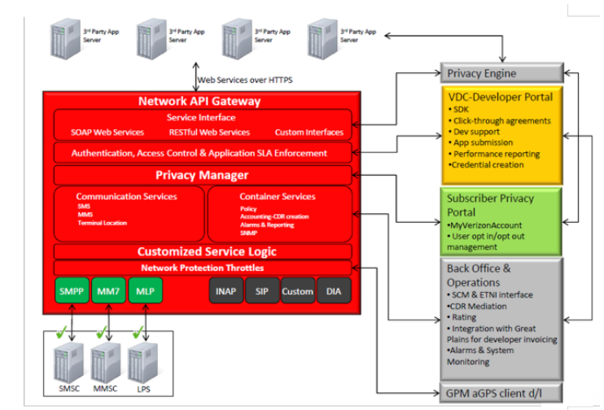
Appendix – Verizon API Architecture

